Slide 1
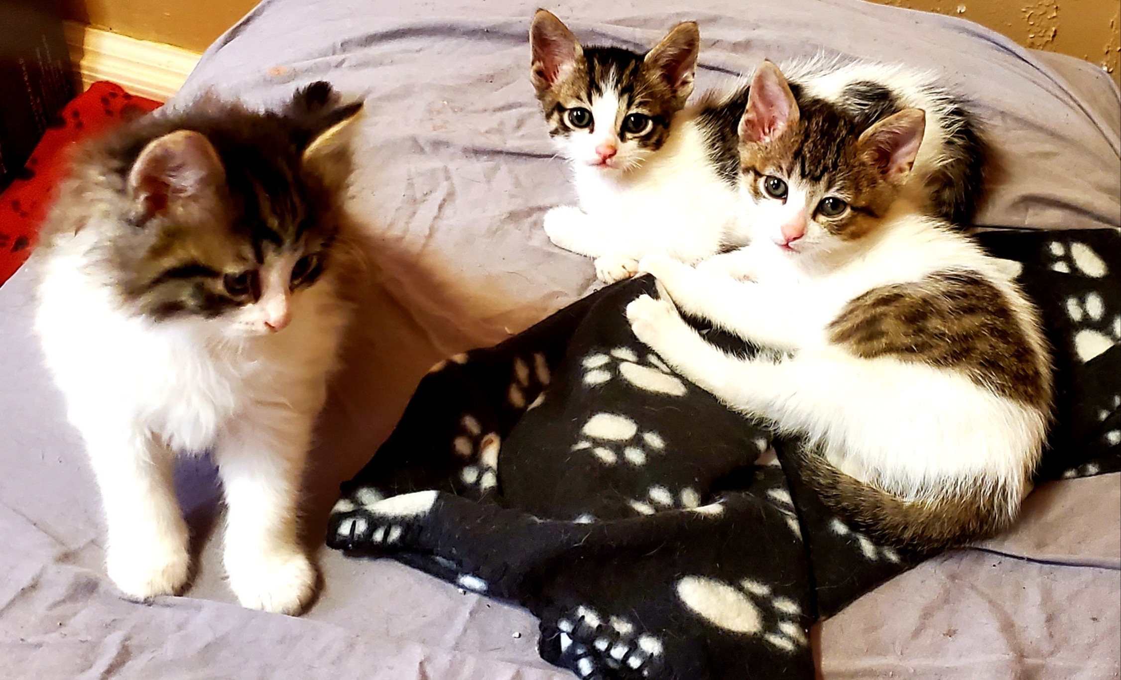
Mission: find your pet!
Elizabeth Schall
Ran Wei
Jagrati Joshi
Nathalie Smith
Veronica Nixon

Slide 2
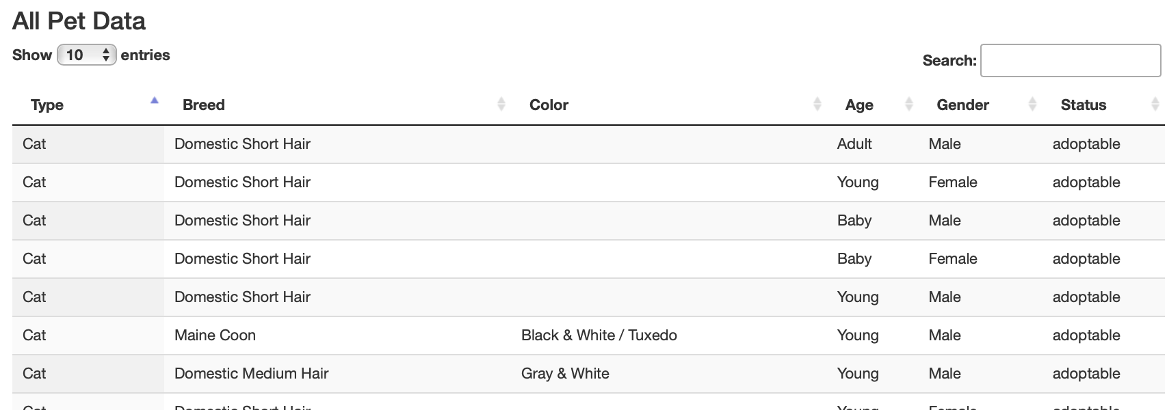
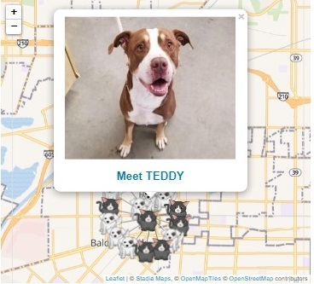
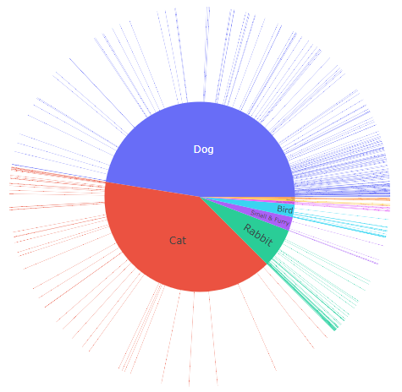


TABLE
MAP
CHART
Nightly update

